Slide 1
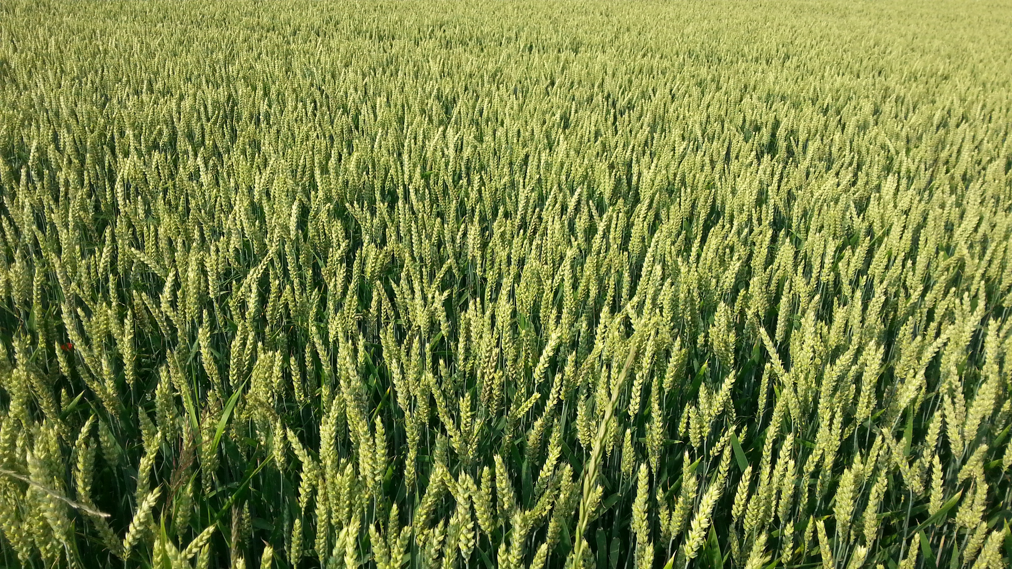

Amplicon sequencing USDA ARS Microbiome Workshop August 29, 2017 Adam R. Rivers

Slide 2
Hello!
The Genomics and Bioinformatics Unit
Brian Scheffler – Research leader
Stoneville, Mississippi
Brian.Scheffler@ars.usda.gov
Adam Rivers – SY Microbiomes and microbial genomes
Gainesville, Florida
Adam.Rivers@ars.usda.gov
Justin Vaughn – SY Crop Genetics
Athens, Georgia
Justin.Vaughn@ars.usda.gov
Amanda Hulse-Kemp – SY Complex and Polyploid Genomes
Raleigh, North Carolina
Amanda.Hulse-Kemp@ars.usda.gov

Slide 3
Learning Objectives
By the end the training you should
What amplicon sequencing is and the questions it can address
Know how amplicon samples are processed
Understand a standard bioinformatics workflow
Know the types of statistical analyses that are possible with amplicon data

Slide 4
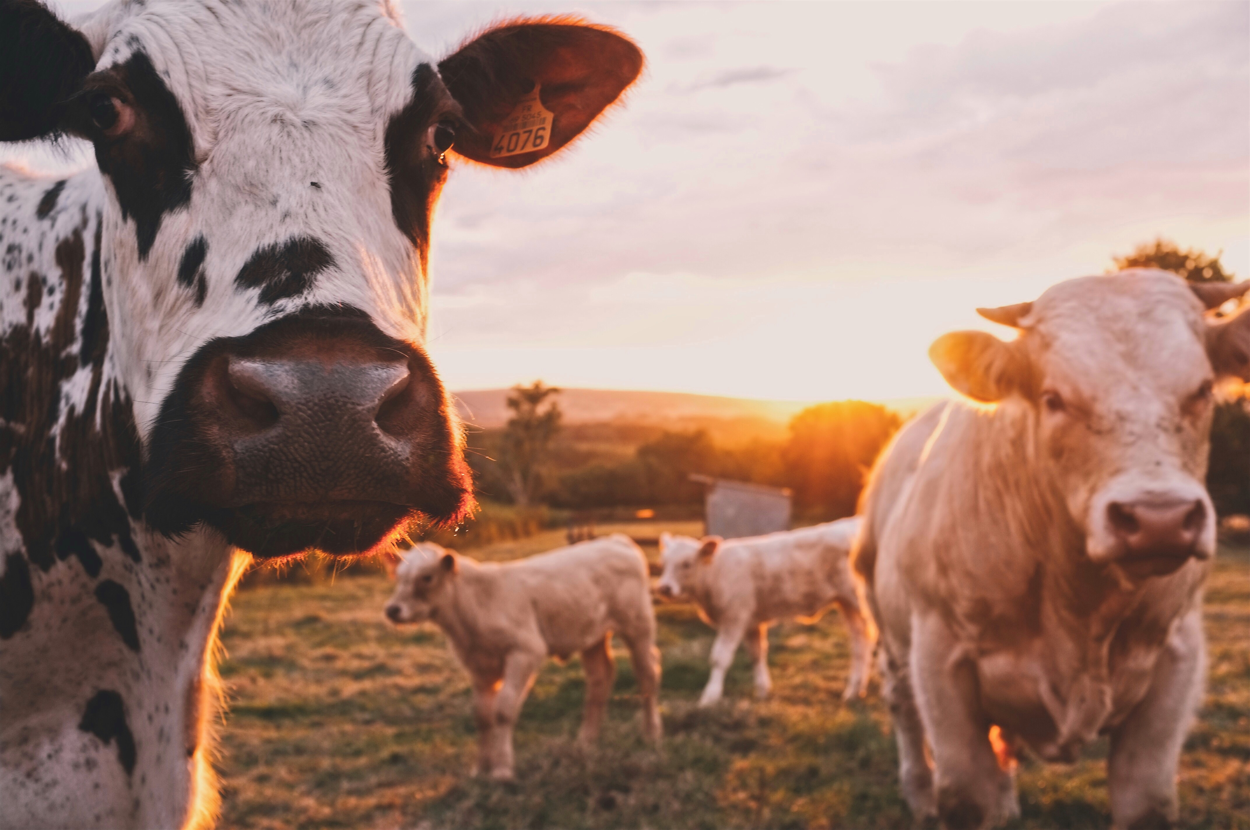
1.
What is amplicon sequencing?

Slide 5
Amplicon sequencing
“Amplicon sequencing is the amplification of a particular gene locus from a mixed group of organisms followed by the random sequencing of those targeted amplicons.”
Which gene?
Which part?
Which primer?
Functional
Taxonomic
Full length
Variable region
Designing good “universal” primers is hard.
NifH
Cox
16S
18S
ITS

Slide 6
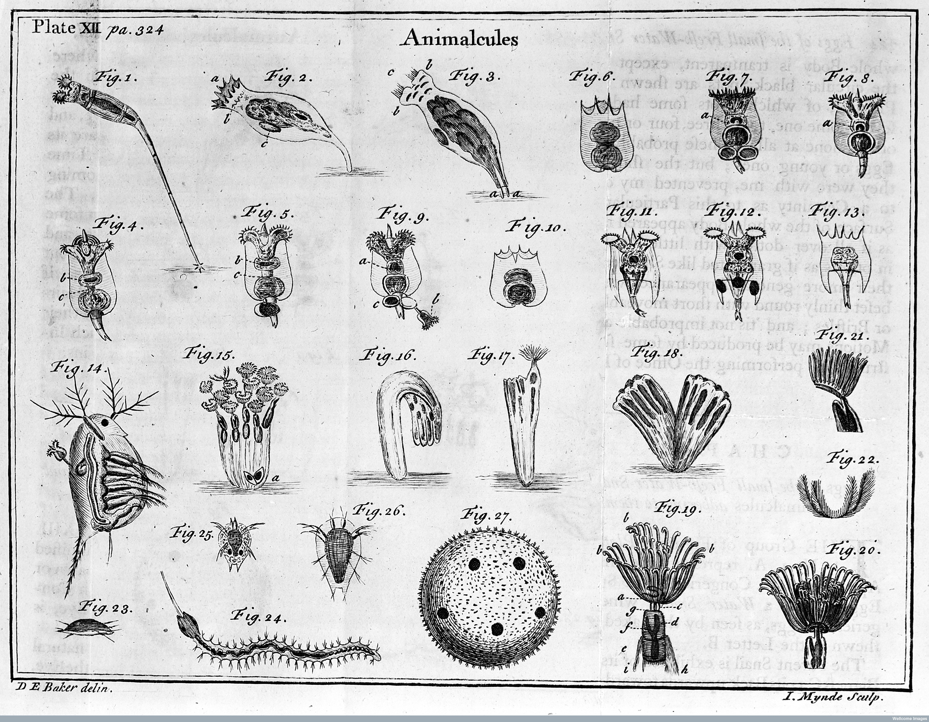
2.
What can amplicon sequencing answer?
Composition, relative abundance, dynamics
Henry Baker (1753)

Slide 7
Composition
At its most basic level amplicon sequencing allows for the taxonomic profiling of communities
Resolution can be a challenge
Different primers can’t be compared
Linking environmental data is hard
Often 16S data is used to select samples of metagenomics
Rivers et al. 2013

Slide 8
Diversity
Alpha, Beta and Gamma diversity (R. H. Whittaker, 1972) are used to describe biodiversity spatially.
Diversity – a combination of richness and evenness
Alpha – within community diversity
Beta – between community diversity (Anderson et al. 2011)
Gamma – total diversity across a study area
(Kemp et al. 2015)
Qiime2 tutorial

Slide 9
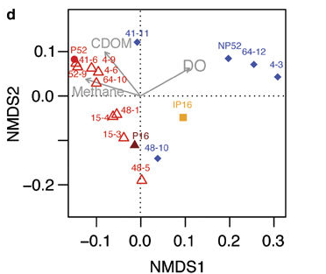
Looking for patterns in communities
Ordination is a dimensionality reduction technique
Start with Taxa vs sample table
Calculate a dissimilarity matrix
Perform ordination, e.g. NMDS, PCA, PCoA,
Fit environmental variables
NMDS from Rivers et al. (2013)
PCA from Kemp et al. (2015)

Slide 10
Looking for co-occurrence
(Ma et al. 2016)

Slide 11
What does co-occurrence mean?
Ideally it maps to an ecological networks
But microbial communities are different…
Direct vs. indirect interaction
Simplex measurements
Vastly different sampling efforts
Artefactual Co-variance
NIMBioS

Slide 12
The Covariance problem
Kurtz et al. 2015
Methods to address this:
SPIEC-EASI
Gniess
Bayesian network methods

Slide 13
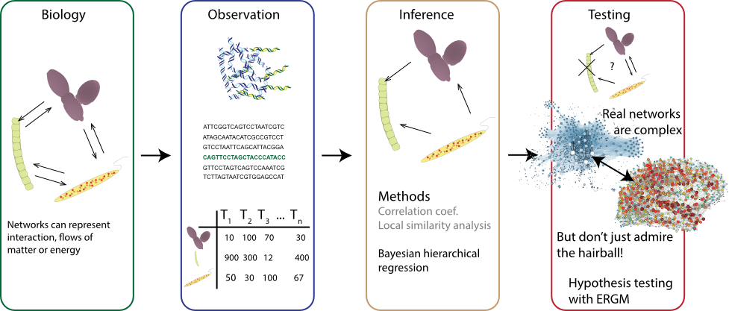
Ecological networks with predictive capability

Slide 14
Types of Microbiome studies
Observational
Who’s there
Diversity
[C] ~ environmental parameters
Co-varying OTUs and network structure
OTUs with significant relationships to gradient
Time series
Dynamic networks, seasonal succession
Few studies have the resolution to use ARIMA, etc.
Repeated measures
Spatial
Spatial scaling latitudinal diversity has been studied
Many GIS tools and methods, Kriging not widely used
Experimental treatments
Experimental manipulation is becoming more complex
Pairwise tests are common, some GLM frameworks
Dealing with normalization, the Simplex and the count distribution are active research areas
Internal standards are sometimes used

Slide 15
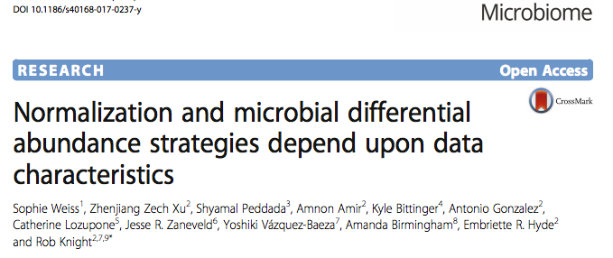
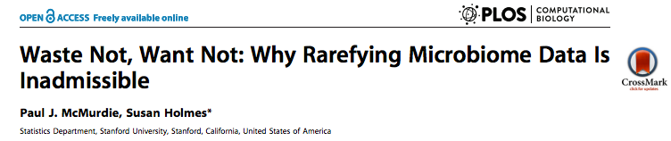
Rarefying, normalizing, oh my!
vs.
Rarefaction subsamples without replacement reads from each sample often to the of the smallest library in an experiment sometimes 10-100x.
Alternatively data can be scaled using a normalization method like the Trimmed Mean of Means transformation and modeled using a negative binomial model.

Slide 16
3.
Field to sequencer – the nuts and bolts.
Sample preparation and sequencing

Slide 17
Collect DNA
Amplicon DNA sampling is much more forgiving than RNA sampling.
4ºC Short-term
-20ºC Long-term
(Rubin et al. 2013)
Collect and store
within 1-2 hours
Consider collecting RNA and storing it in RNAlater (Saturated Ammonium Sulfate) at 4ºC to sequence the active fraction.

Slide 18
Collect Metadata
“There is no such thing as metadata, everything is data.”
- Susan Holmes
Sample collection is the time to record environmental data
The GSC has created environmental and sequence data standards, MIxS. Use them as a guide for your collections.
Store environmental data in NCBI or ENA Biosamples databases or Gold database. Do it now, while you still remember what you did. You can link sequence data later.

Slide 19
DNA extraction
Amplicon sequencing is more forgiving than metagenome sequencing.
Target amount of DNA for sequencing:
50-100ng at 3-50 ng/ul in 10-50 ul
About 10ng is needed, but who wants to have just the bare minimum of Flair DNA?
Quality:
Length is less important than amplification.
PCR test with universal part of sequencing primers.
PCR inhibitors like humic acids can be most disruptive.
Internal standards:
For quantitative work control DNA is sometimes added during extraction (Moran et al. 2013).

Slide 20
Amplicon Processing
Quantification of DNA
Barcoding and Amplification
LAB PROCESS
Quantification of amplicons and pooling
Sequencing

Slide 21
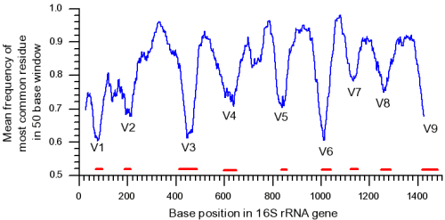
Sequencing primers
515F
806R
Current: V4

Slide 22
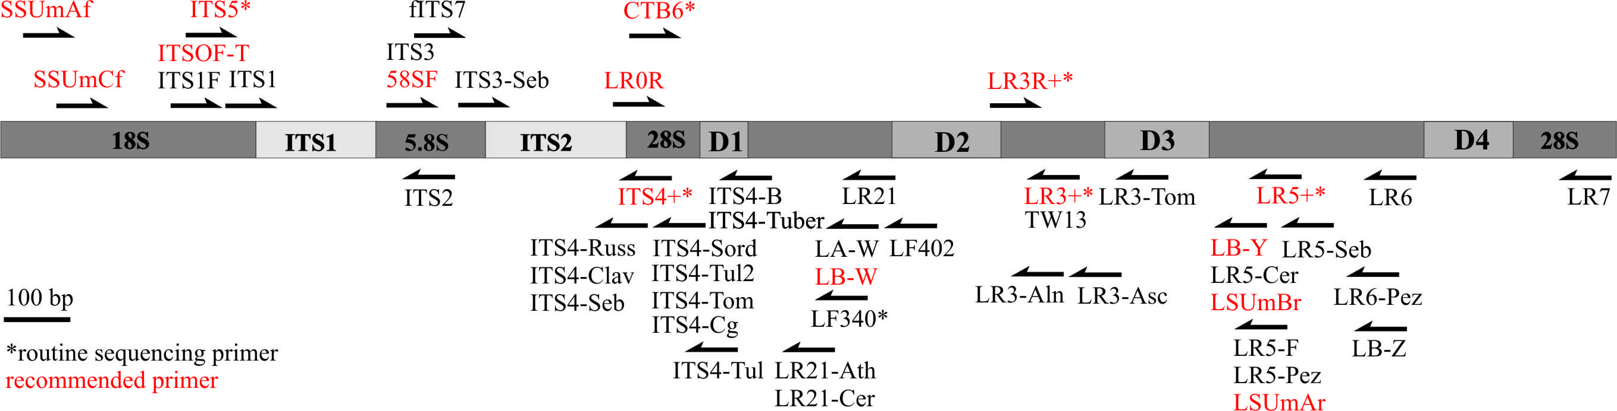
Sequencing primers
Sequenced Fungal ITS2 Region
ITS9
ITS4

Slide 23
Sequencing primers
V4
16S
515FB GTGYCAGCMGCCGCGGTAA Caporaso et al. 2012 Updated EMP
806RB GGACTACNVGGGTWTCTAAT Caporaso et al. 2012 Updated EMP
565F CCAGCASCYGCGGTAATTCC Stoeck et al. 2010
948R ACTTTCGTTCTTGATYRA Stoeck et al. 2010
ITS9F GAACGCAGCRAAIIGYGA Menkis et al. 2012
ITS4R TCCTCCGCTTATTGATATGC White et al. 1990
V4
18S
18S
5.8S
ITS2
28S

Slide 24
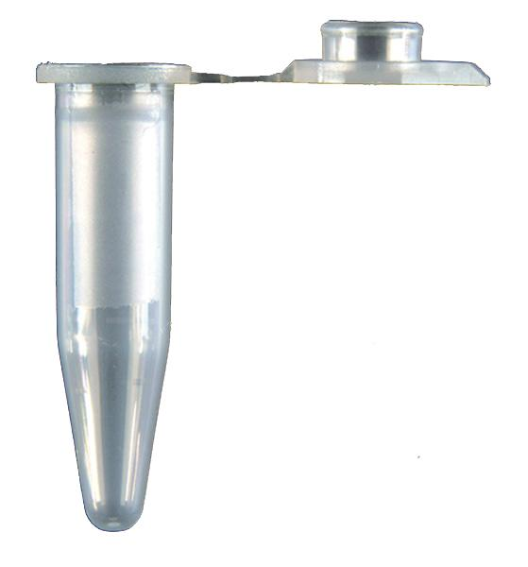
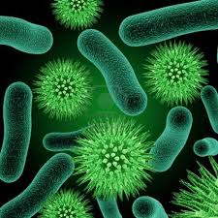
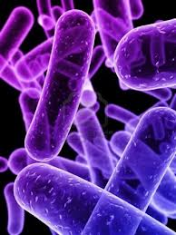
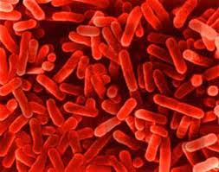
Barcoding
V4
#1
Amplification with
barcodes
#2
Pool
And sequence
#3
Clustering,
Barcode binning,
Taxonomy
assignment
Species
Variable region
Sample Barcodes
ACCTG
ACA
TACGC
TCG
GAAGC
GAT
1 | 1 | 3
1 | 0 | 0
1 | 2 | 0
24

Slide 25
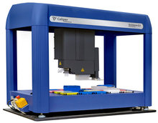
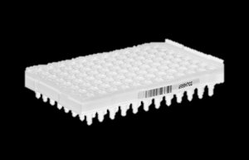
Sequencing
MiSeq
PCR with 16 forward primer
24 distinct reverse indexes
2 96 well plates
2x300bp Paired Reads
44-50M reads
~360,000 tags per sample
36 hours

Slide 26
4.
Analysis of amplicon data
GATC
CATC
CCGA
What to do with all those fastq.gz files.

Slide 27
Amplicon sequencing
Amplicon analysis follows a basic workflow with many possibilities for custom analysis
Quality control and OTU or Sequence Variant selection
Taxonomic
assignment
Analysis:
Ecological, Diff. abundance, Networks
etc.

Slide 28
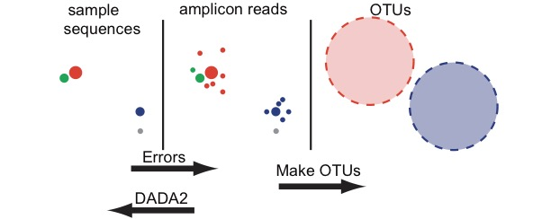
Why OTU’s were used and why Sequence variants are replacing them.
Callahan et al. 2016
Callahan et al. 2017
The field is moving this way:
Dada2 - Callahan et al. 2016 (Holmes Lab)
Denoise - Amir et al. 2017 (Knight Lab)
Unoise2 – Edgar 2016

Slide 29
Taxonomic assignment
Databases
Database | Description | License
Greengenes | A curated database of archaea and bacteria - static since 2013 | CC BY-SA 3.0
Silva | The most up-to-date and extensive database of prokaryotes and eukaryotes, several versions | Free academic / Paid commercial license
The RDP database | A large collection of archaeal bacterial and fungal sequences | CC BY-SA 3.0
UNITE | The primary database for fungal ITS and 28S data | Not stated
Classifiers
RDP Classifier – The go-to NB classifier for most people
Sintax – Edgar’s short Kmer classifier
Qiime2’s - NB classifier based on Scikit learn

Slide 30
Analysis
The range of analysis preformed after 16S is wide:
Taxonomic profiling
Differential abundance analysis
Diversity measurement
Network analysis
Hypothesis testing
Identifying responsive SV’s
Correlating taxa with environmental conditions
Understanding how related taxa are.
Is best to jump in and try these yourself in the Amplicon Tutorial

Slide 31
Photo credits
1: DNA - Made By MadeByOliver from Flaticon.com
1: Wheat - Photo by Kai Pilger on Unsplash
4: glacier Photo by Patrícia Cassol Pereira on Unsplash

Slide 32
Instructions for use
EDIT IN GOOGLE SLIDES
Click on the button under the presentation preview that says "Use as Google Slides Theme".
You will get a copy of this document on your Google Drive and will be able to edit, add or delete slides.
You have to be signed in to your Google account.
EDIT IN POWERPOINT®
Click on the button under the presentation preview that says "Download as PowerPoint template". You will get a .pptx file that you can edit in PowerPoint.
Remember to download and install the fonts used in this presentation (you’ll find the links to the font files needed in the Presentation design slide)
More info on how to use this template at www.slidescarnival.com/help-use-presentation-template
This template is free to use under Creative Commons Attribution license. You can keep the Credits slide or mention SlidesCarnival and other resources used in a slide footer.

Slide 34
This template is for a SlideDoc
A slidedoc is a visual document, developed in presentation software, that is intended to be read and referenced instead of projected.
Slidedocs help you spread your smart thinking by combining visual communications with short chunks of written copy. Their scannable nature makes them great pre-read, reference, and leave-behind materials. Their modularity makes it easy for people to incorporate your ideas into their own communications. And these features together make slidedocs the perfect companion to both written documents and presentations.
Text from duarte.com/slidedocs

Slide 35
Table of contents
Section one
Section two
Even another section
And there can be subsections too.
Subsection
Section four
This is a template optimized for SlideDocs. As it is a long document you should inform the reader about its contents.

Slide 36
Quotations are commonly printed as a means of inspiration and to invoke philosophical thoughts from the reader.

Slide 37
This is a slide title
SlideDocs are for distribution; they’re not optimized for presenting. Slides have too much text and font size is too small for an audience to read it projected in a screen.
These documents are useful for:
Distribute before a meeting when the topic is highly complex or technical
To fully explain your idea before booking a meeting with someone
As a reference and follow-up material
Distribute
Explain
Follow-up

Slide 38
BIG CONCEPT
Bring the attention of your audience over a key concept using icons or illustrations

Slide 39
You can also split your content
Try to communicate ideas visually using graphs, icons, illustrations, photos… any resource that helps you convey your message at a glance.
White
Is the color of milk and fresh snow, the color produced by the combination of all the colors of the visible spectrum.
Black
Is the color of coal, ebony, and of outer space. It is the darkest color, the result of the absence of or complete absorption of light.

Slide 40
In two or three columns
Yellow
Is the color of gold, butter and ripe lemons. In the spectrum of visible light, yellow is found between green and orange.
According to surveys in Europe, Canada, and the United States, yellow is the color people most often associate with amusement, gentleness, and spontaneity, but also with duplicity, envy, jealousy, avarice, and, in the U.S., with cowardice.
It plays an important role in Asian culture, particularly in China, where it is seen as the color of happiness, glory, wisdom, harmony, and culture.
Blue
Is the colour of the clear sky and the deep sea. It is located between violet and green on the optical spectrum.
Surveys in the US and Europe show that blue is the colour most commonly associated with harmony, faithfulness, confidence, distance, infinity, the imagination, cold, and sometimes with sadness.
In US and European public opinion polls it is the most popular colour, chosen by almost half of both men and women as their favourite colour.
Red
Is the color of blood, and because of this it has historically been associated with sacrifice, danger and courage.
Modern surveys in the United States and Europe show red is also the color most commonly associated with heat, activity, passion, sexuality, anger, love and joy. Red is also a color widely used for getting attention, such as stop signs or royal dresses.
In China, India and many other Asian countries it is the color of symbolizing happiness and good fortune.

Slide 41

A picture is worth a thousand words
A complex idea can be conveyed with just a single still image, namely making it possible to absorb large amounts of data quickly.

Slide 42

Want big impact? Use big image.

Slide 43
Use charts to explain your ideas
Item 1
Item 2
THE
CONCEPT
Item 3
Item 4

Slide 44
And tables to compare data
As a communication tool, a table allows a form of generalization of information from an unlimited number of different social or scientific contexts. It provides a familiar way to convey information that might otherwise not be obvious or readily understood.
 | A | B | C
Yellow | 10 | 20 | 7
Blue | 30 | 15 | 10
Orange | 5 | 24 | 16

Slide 45
Maps
our office
The word "map" comes from the medieval Latin Mappa mundi, wherein mappa meant napkin or cloth and mundi the world.

Slide 46
89,526,124
Whoa! That’s a big number, aren’t you proud?

Slide 47
And even more numbers
89,526,124$
That’s a lot of money
185,244 users
And a lot of users
100%
Total success!

Slide 48
Our process is easy
last
second
first

Slide 49
Let’s review some concepts
Yellow
Is the color of gold, butter and ripe lemons. In the spectrum of visible light, yellow is found between green and orange.
Blue
Is the colour of the clear sky and the deep sea. It is located between violet and green on the optical spectrum.
Red
Is the color of blood, and because of this it has historically been associated with sacrifice, danger and courage.
Yellow
Is the color of gold, butter and ripe lemons. In the spectrum of visible light, yellow is found between green and orange.
Blue
Is the colour of the clear sky and the deep sea. It is located between violet and green on the optical spectrum.
Red
Is the color of blood, and because of this it has historically been associated with sacrifice, danger and courage.

Slide 50
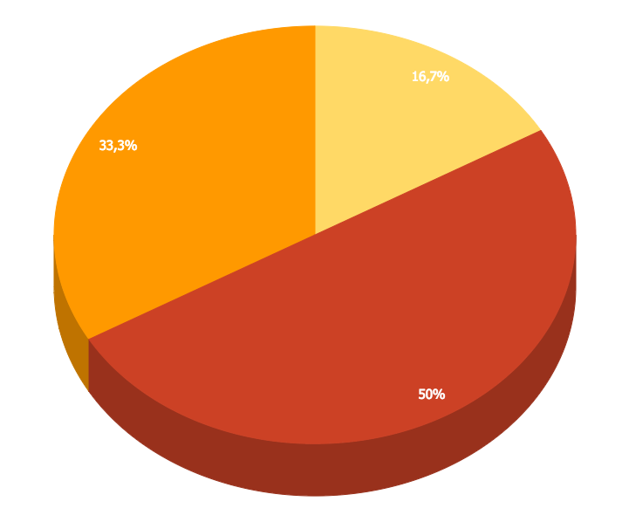
You can insert graphs from Google Sheets

Slide 51
Android Project
Place your screenshot here
Show and explain your web, app or software projects using these gadget templates.

Slide 52
iPhone Project
Place your screenshot here
Show and explain your web, app or software projects using these gadget templates.

Slide 53
Tablet
Project
Place your screenshot here
Show and explain your web, app or software projects using these gadget templates.

Slide 54
Desktop Project
Place your screenshot here
Show and explain your web, app or software projects using these gadget templates.

Slide 55

Thank you very much for your time
If you have any questions about this document please don’t hesitate to contact us at:
www.ourwebsite.com
hello@mail.me
@companyname

Slide 56
Credits
Special thanks to all the people who made and released these awesome resources for free.
Presentation template by SlidesCarnival
Photographs by Unsplash
Learn more about slidedocs at duarte.com/slidedocs

Slide 57
Presentation design
This presentation uses the following typographies and colors:
Titles: Nunito sans
Body copy: Nunito sans
Italic copy: Georgia (system font)
You can download the font on this page:
https://fontlibrary.org/en/font/nunito-sans
Orange #f67031
Yellow #ffa400
Fucsia #ed0036
You don’t need to keep this slide in your presentation. It’s only here to serve you as a design guide if you need to create new slides or download the fonts to edit the presentation in PowerPoint®

Slide 58
SlidesCarnival icons are editable shapes.
This means that you can:
Resize them without losing quality.
Change line color, width and style.
Isn’t that nice? :)
Examples:

Slide 59
😉
Now you can use any emoji as an icon!
And of course it resizes without losing quality and you can change the color.
How? Follow Google instructions https://twitter.com/googledocs/status/730087240156643328
✋👆👉👍👤👦👧👨👩👪💃🏃💑❤😂😉😋😒😭👶😸🐟🍒🍔💣📌📖🔨🎃🎈🎨🏈🏰🌏🔌🔑 and many more...

